Slide 1

Reviews Analysis
By: Dhanashree Nangre

Slide 2
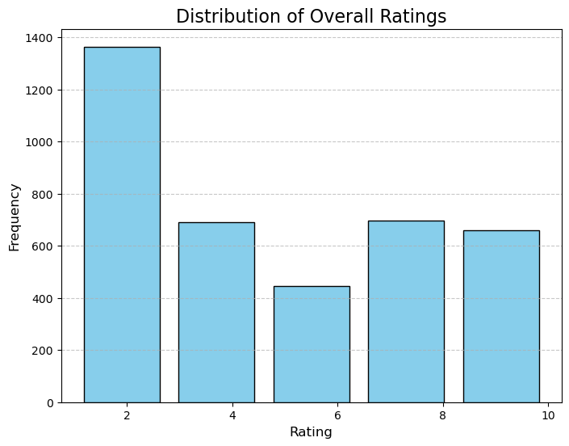
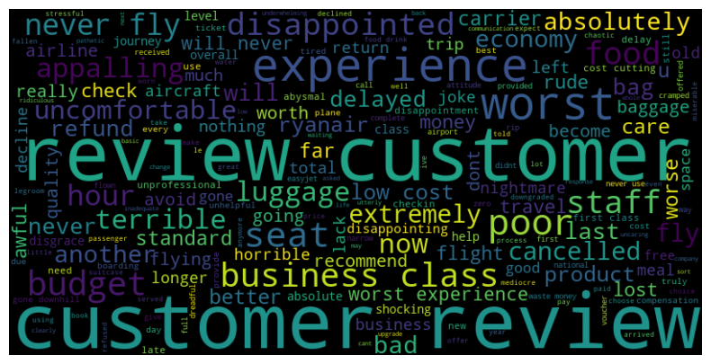
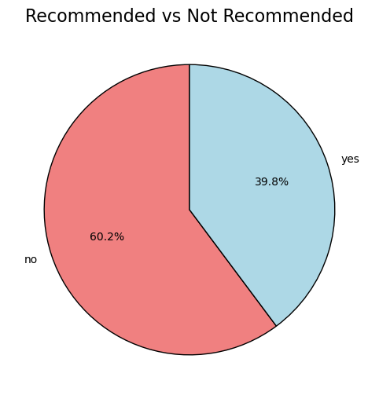
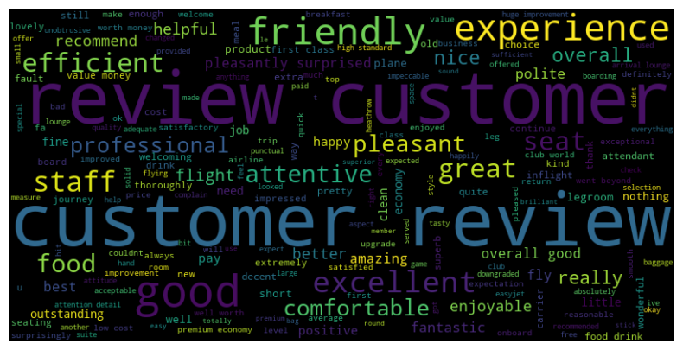
Word cloud of negative reviews:
Word cloud of positive reviews:
Positive review:
Rating is >=7 is 35.2%
Neutral review:
Rating is >=4 is 18.2%
Negative review:
Rating is <4 is 18.2%

